Slide 1
IIoT & Industrial Automation Development WorkBench
TEKTORK PRIVATE LIMITED

Slide 2
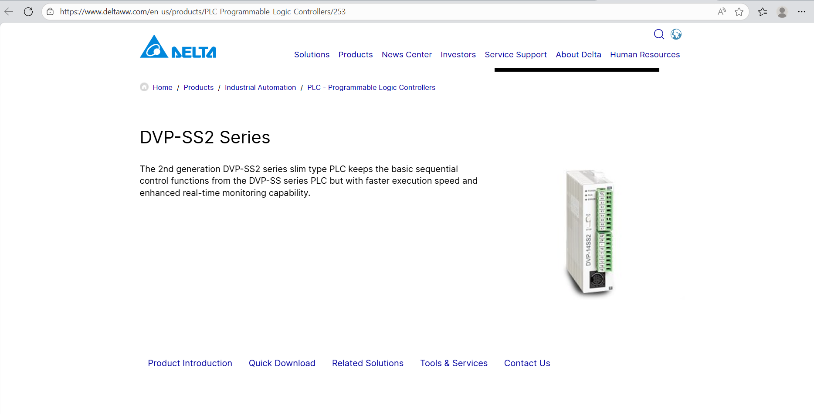
DVP-SS2 Series Download

Slide 3
Software Installation Procedure and Datasheet Download for corresponding PLC’s
Products - PLC - Programmable Logic Controllers - Delta
Once the link opens, select the Quick Download option.
There is an option called ISPSoft and WPLSoft.
ISPSoft V3.22.01
WPLSoft V2.53
But currently, we are using ISPSoft because it is compatible with all kinds of PLCs
DIAStudio V1.0 Register & Download Manual

Slide 4
HMI (Human-Machine Interface) Manual and Software Tool
VS,VS-Q installation manual-1.pdf
Software Download - INVT Electric Global

Slide 5
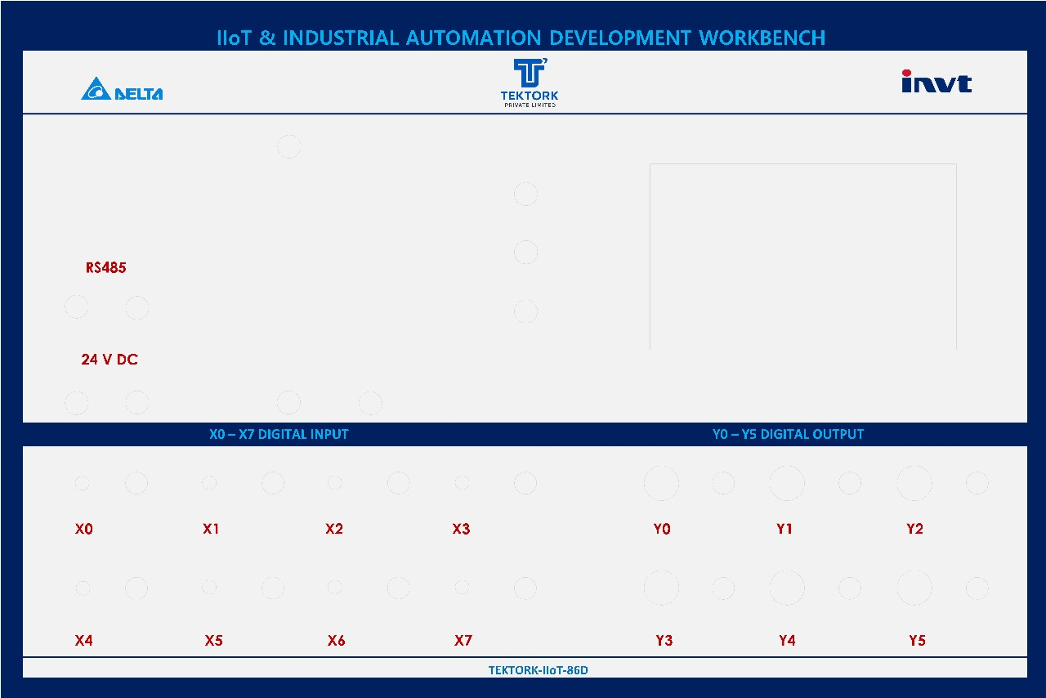
8 Digital Inputs (X0-X7) and 6 Digital Outputs (Y0-Y5)

Slide 6
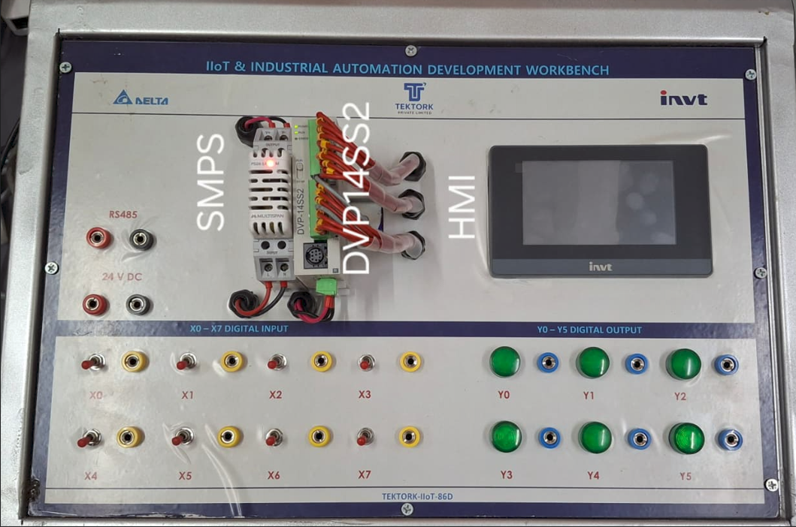
IIoT & Industrial Automation Development Board

Slide 7
Three Cables: Power Supply and Two System Interface USB Cables
There are three cables:
One is the power supply cable for 230 V,
Another is the PLC programming cable, which is connected to the PLC on one end and to the system via a USB connector on the other end,
The third is the built-in HMI interface cable, which also connects to the system through a USB port.

Slide 8
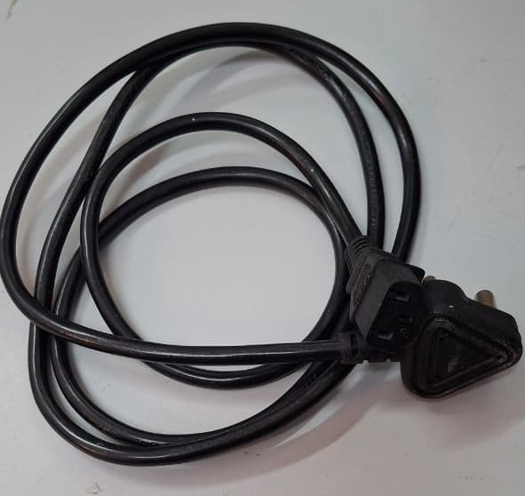
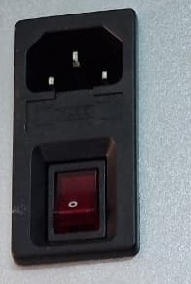
Power Supply Cable

Slide 9
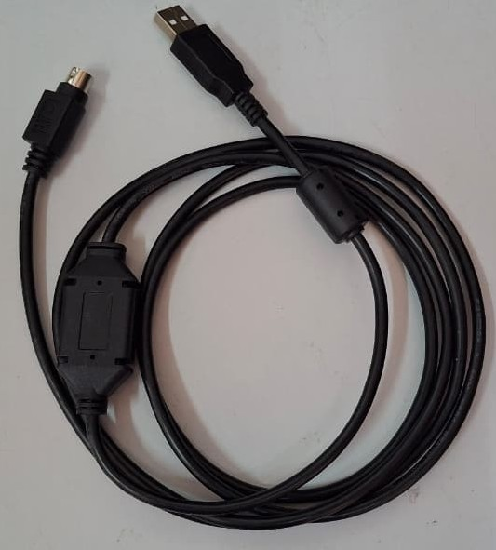
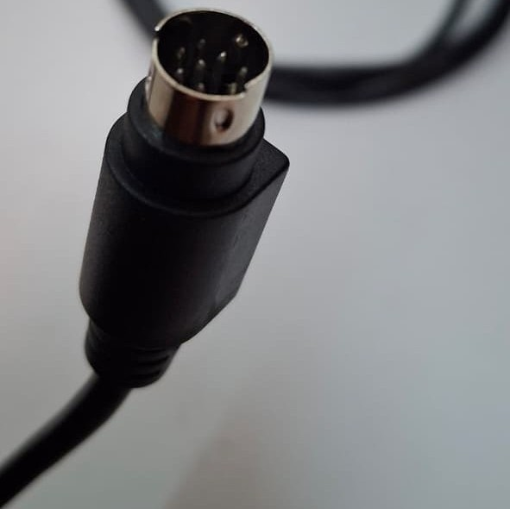
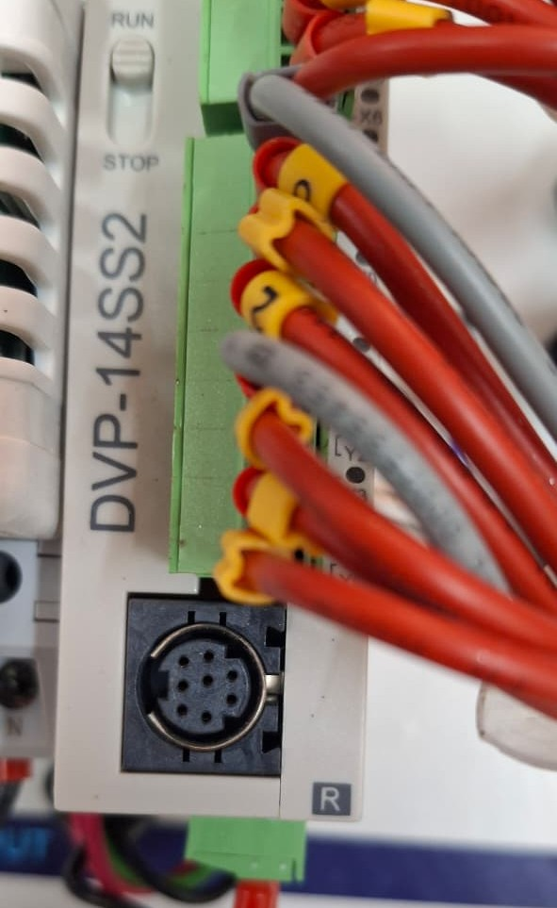
PLC Programming Cable

Slide 10
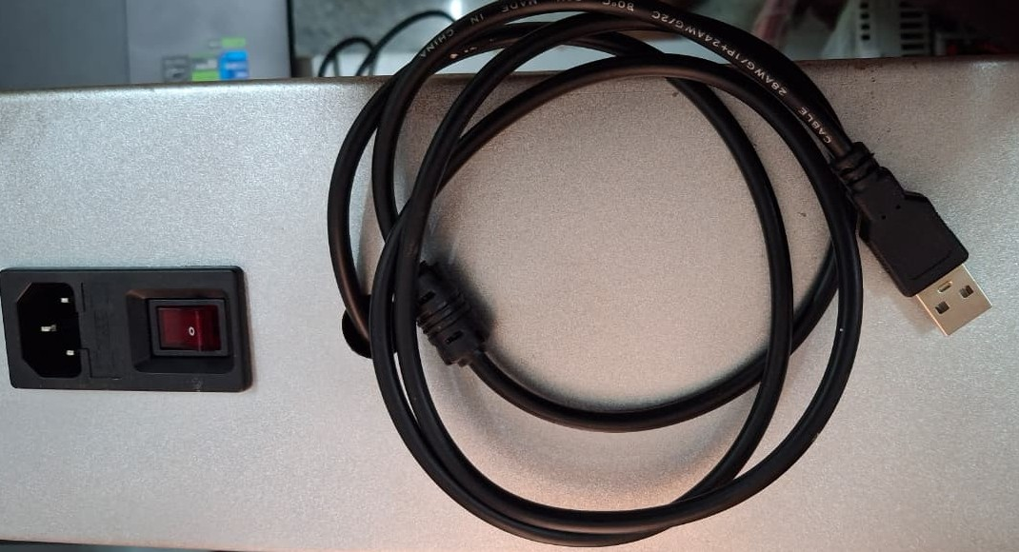
Inbuild HMI Cable for HMI Programming

Slide 11
Bottom side of the PLC there is two wire, and three wire connections are there
Two wire connection are called it is as Modbus data communications RS-485 (+ and -)
Power supply connections are called it is Positive Voltage and negative Voltage and Ground connections.

Slide 12
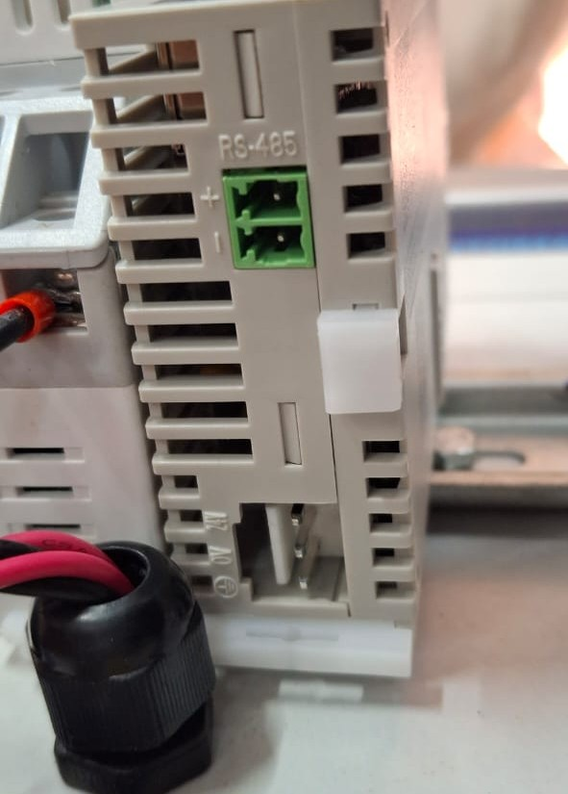
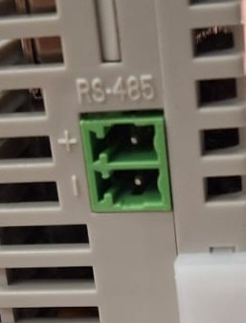
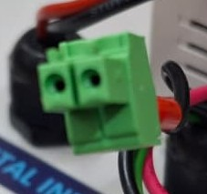
Modbus communication using a two-wire interface

Slide 13
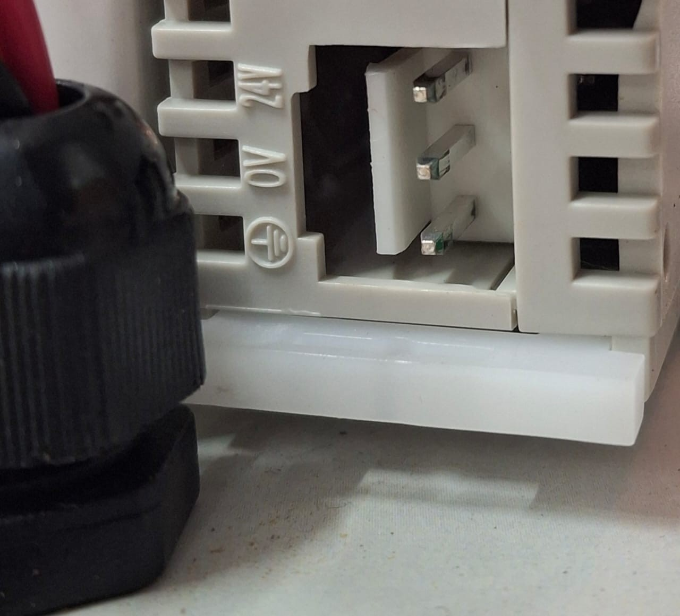
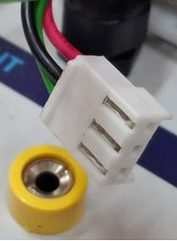
Power source for the PLC system provides 24V with positive and negative terminals, as well as a ground (GND) terminal

Slide 14
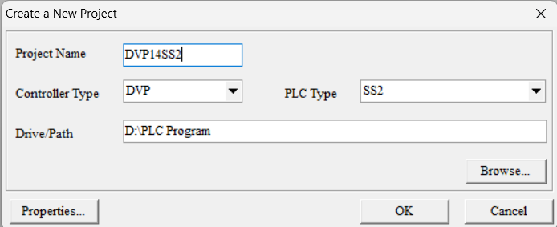
Create a New Project

Slide 15
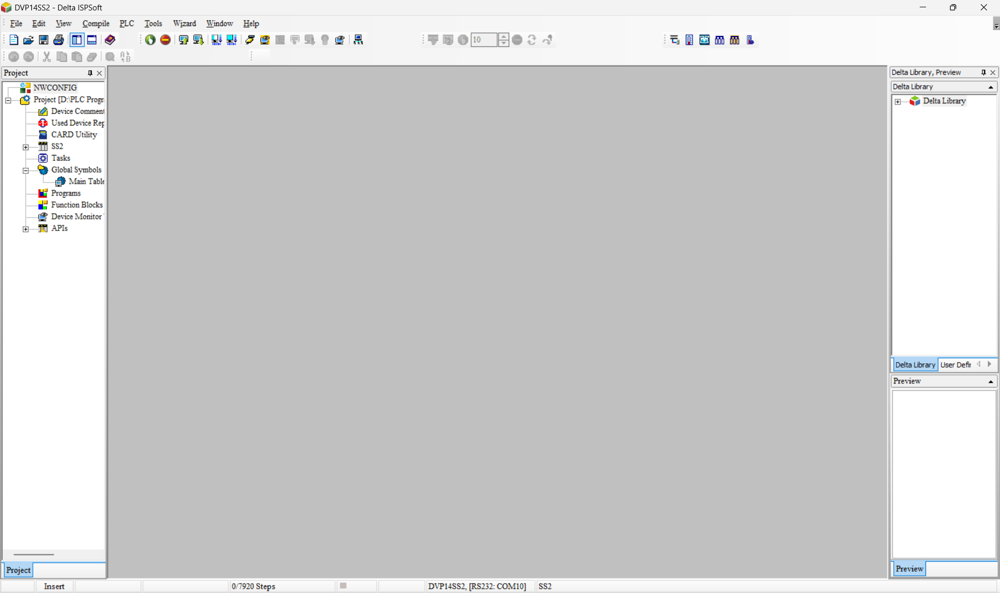
Once after the Create a new Project

Slide 16
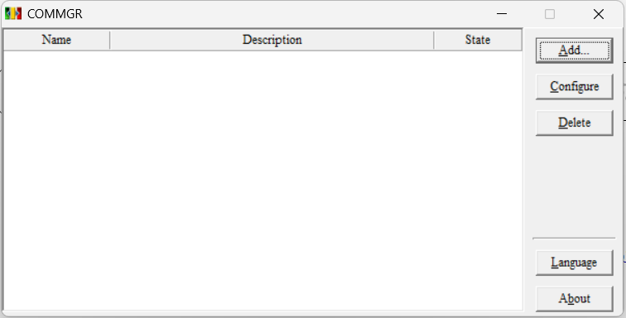
Before starting the new project, we ensure that the Commgr functionality is working properly. Commgr stands for Communication Manager

Slide 17
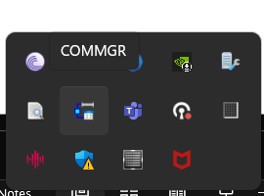
In the Commgr selection process, select the shortcut icon as shown below.

Slide 18
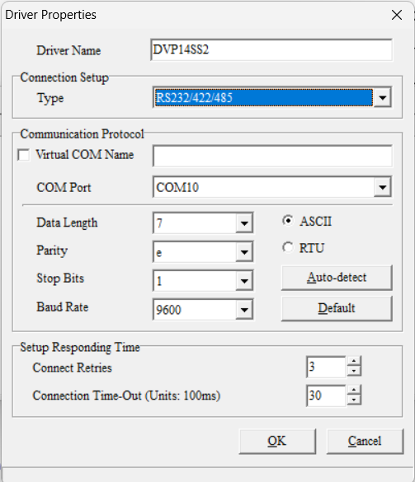
Selection of specific parameters, such as panel communication, is done through the serial configuration.

Slide 19
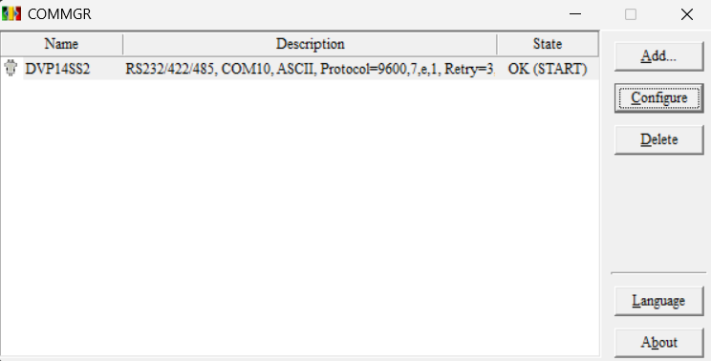
State is OK(START)

Slide 20
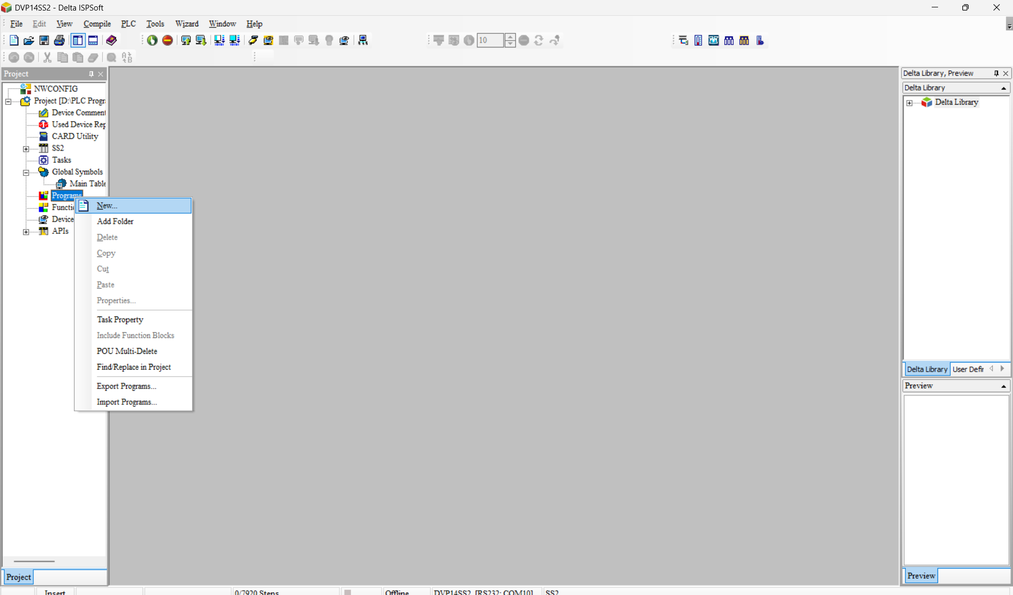
Select ‘New’ in the program.

Slide 21
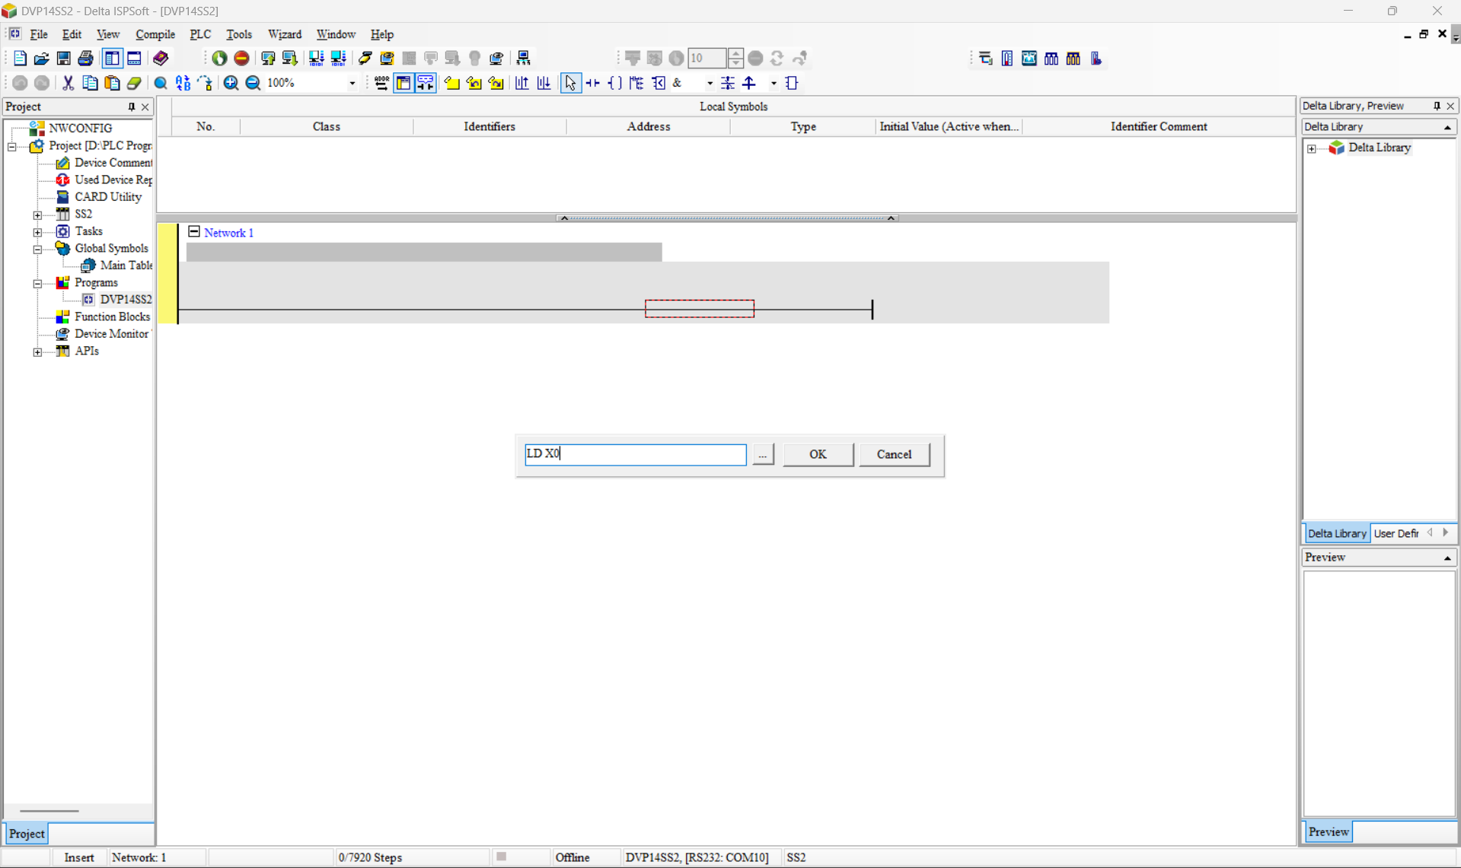
Assigning X0 as Digital Input

Slide 22
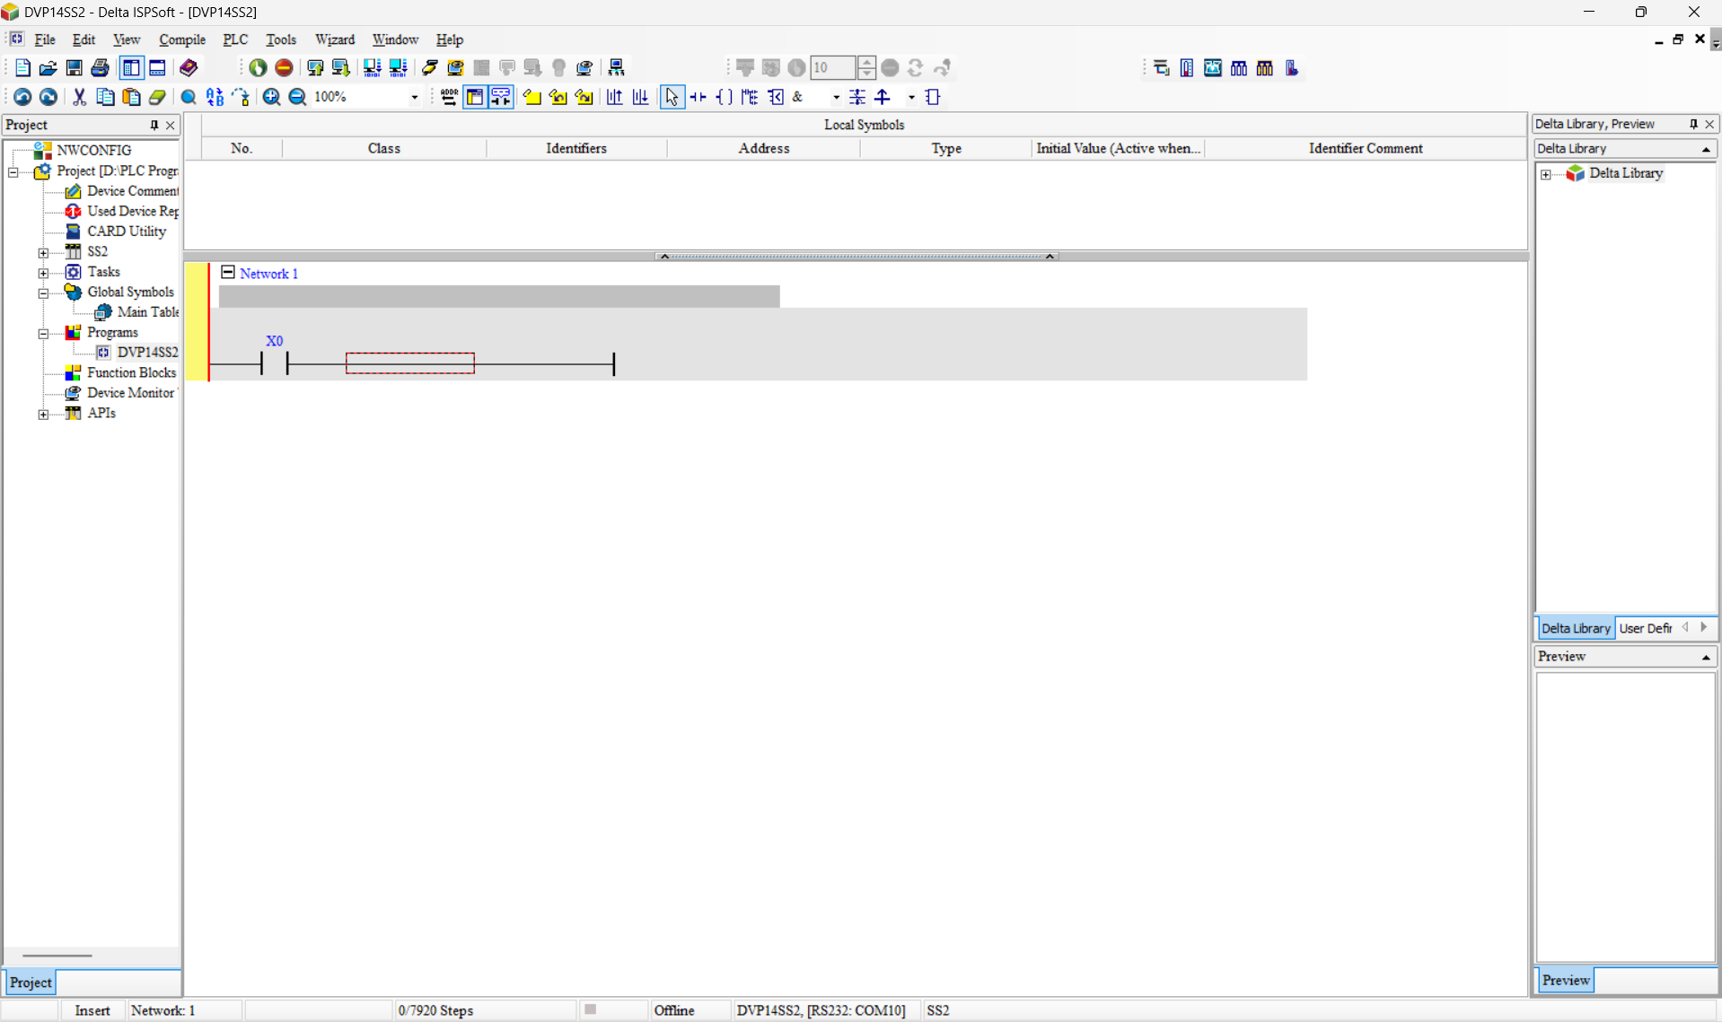

Slide 23
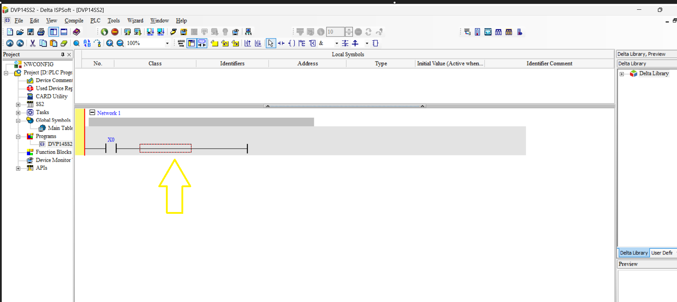
Double-click the highlighted arrow mark

Slide 24
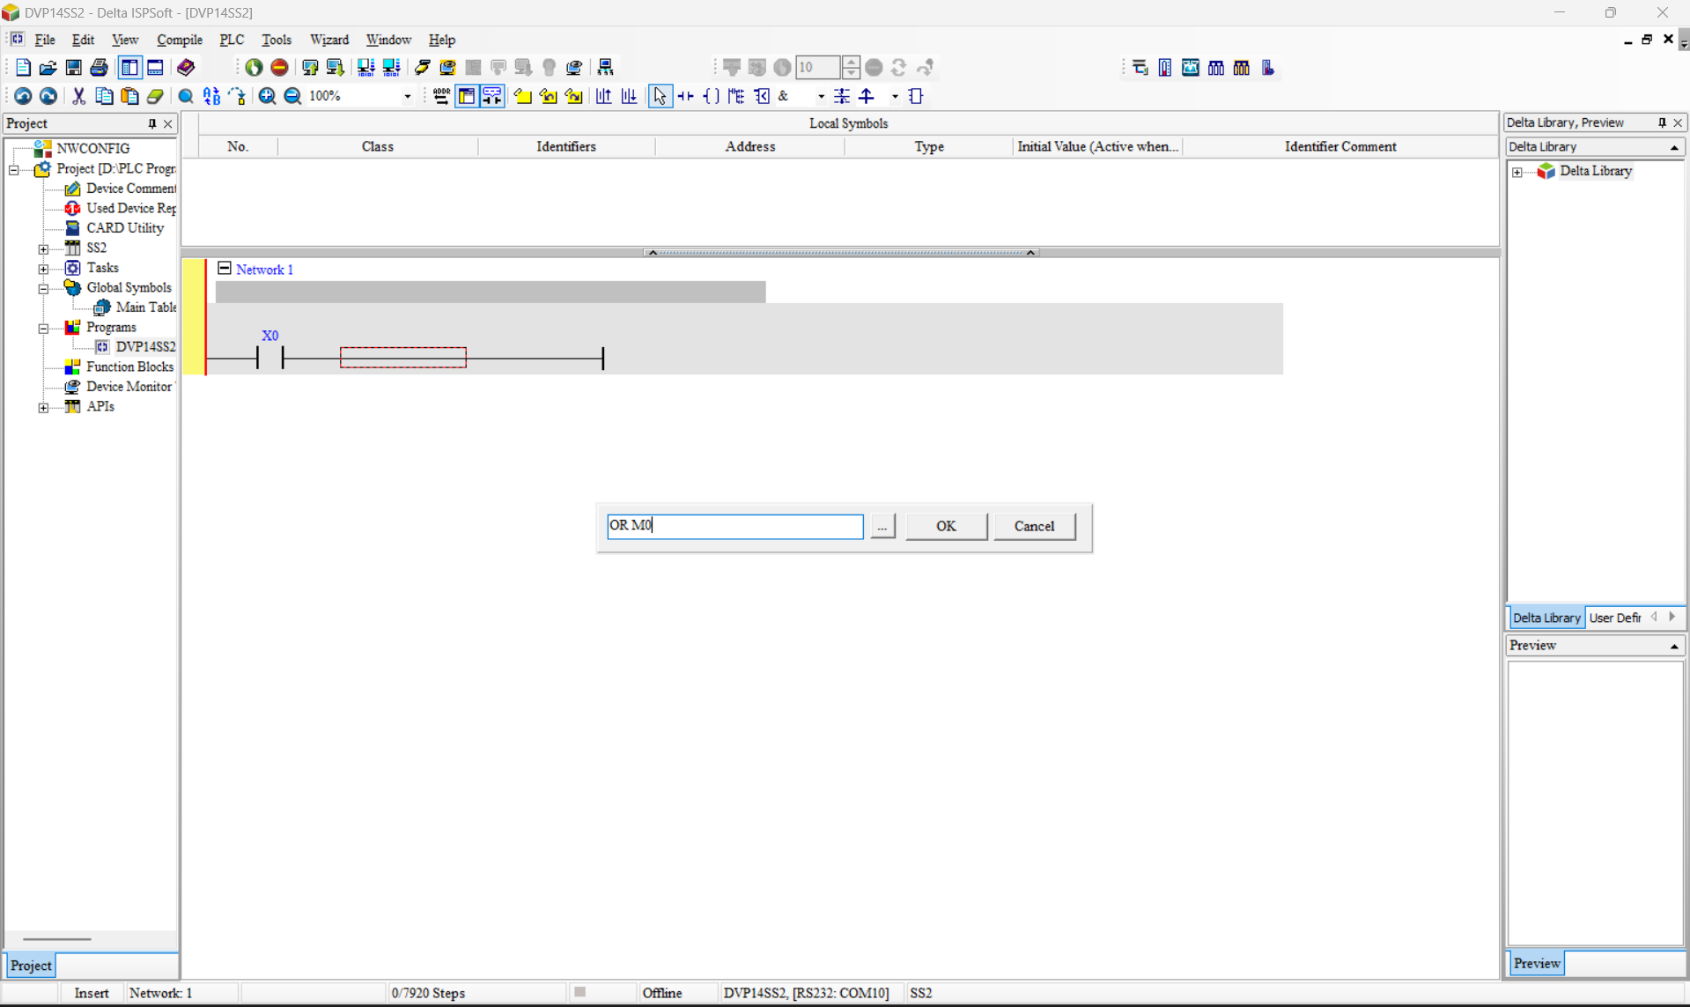
Memory Coil M0 Parallel to X0.

Slide 25
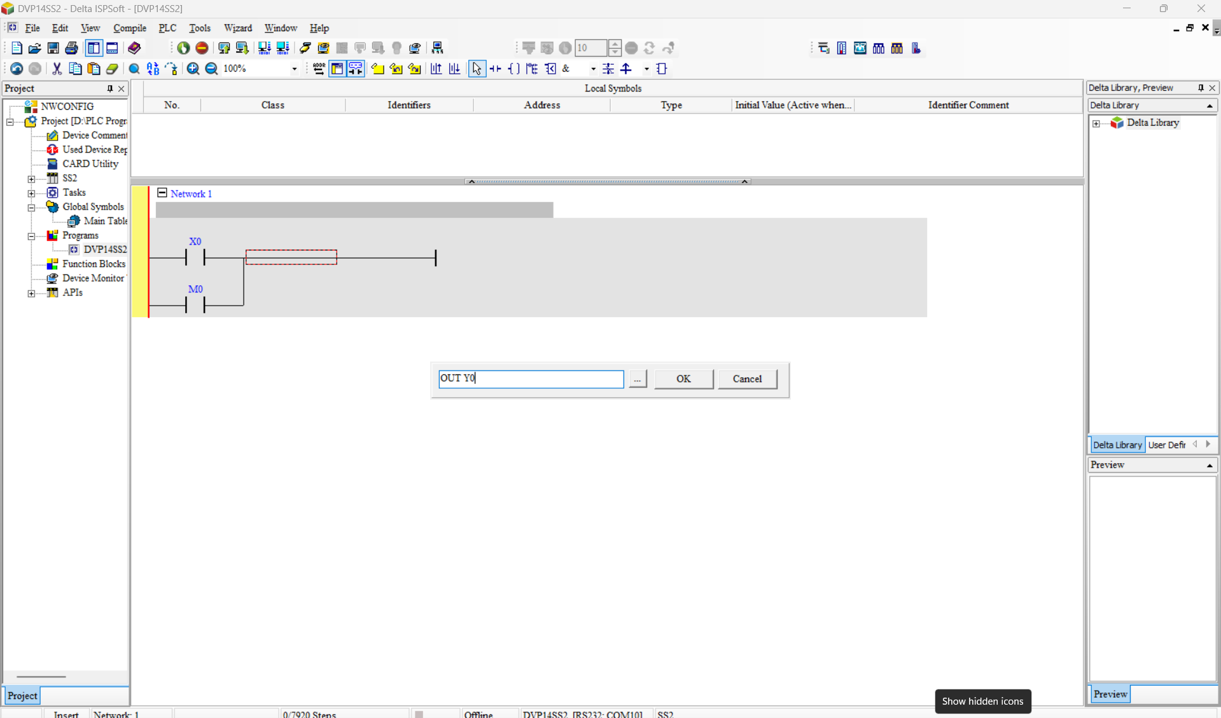
Assigning Y0 as Output

Slide 26
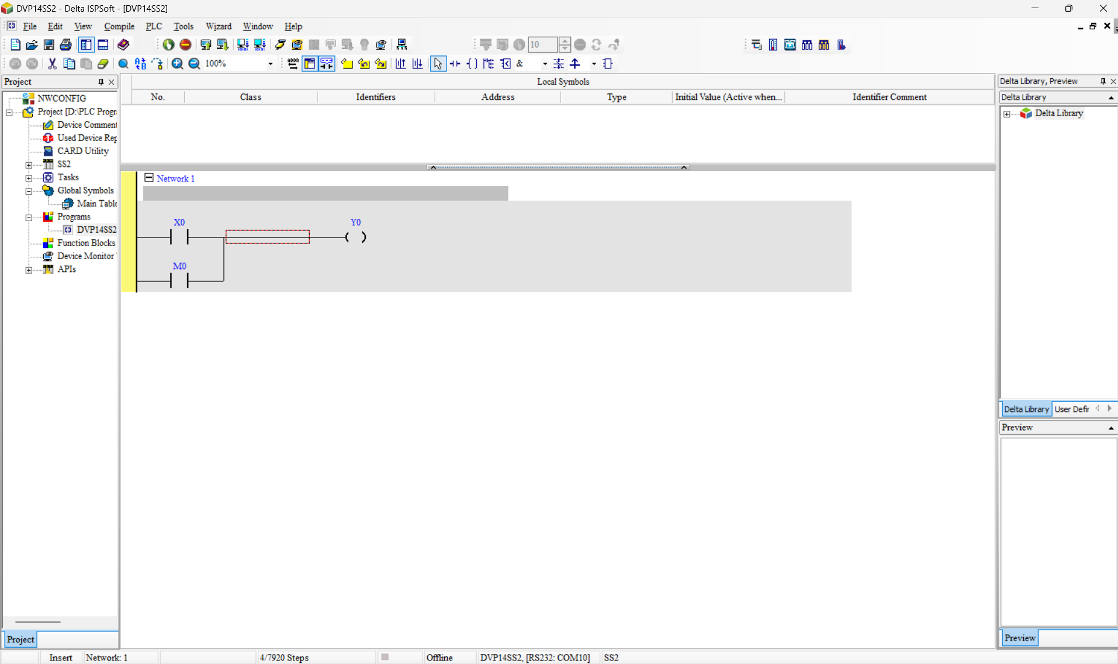
Simple: X0 as Input and Y0 as the corresponding Output.

Slide 27
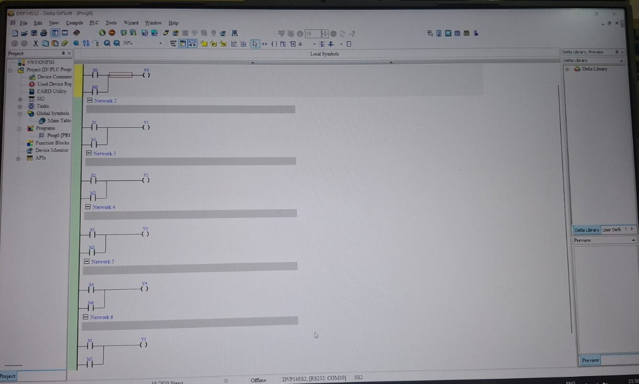
The same procedure is followed for X0–X5 and Y0–Y5.

Slide 28
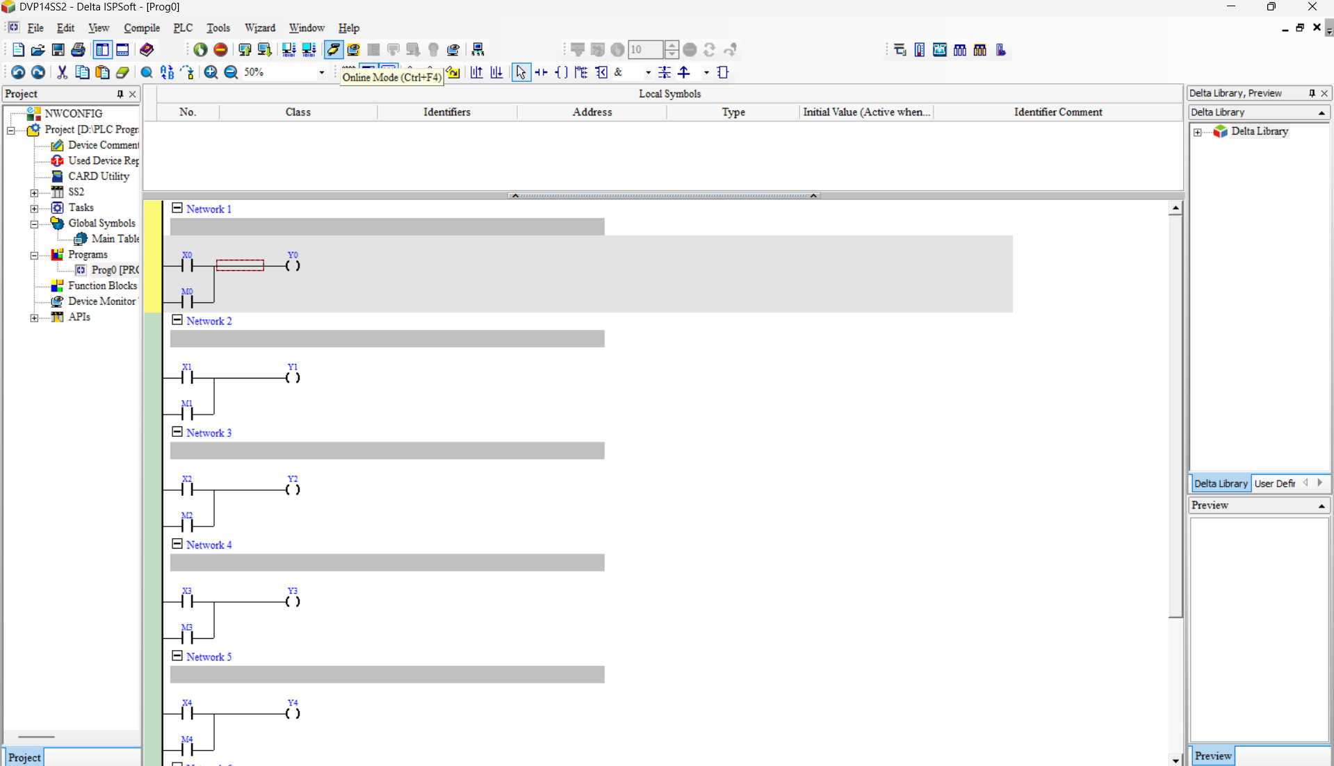
Choose the online mode option

Slide 29
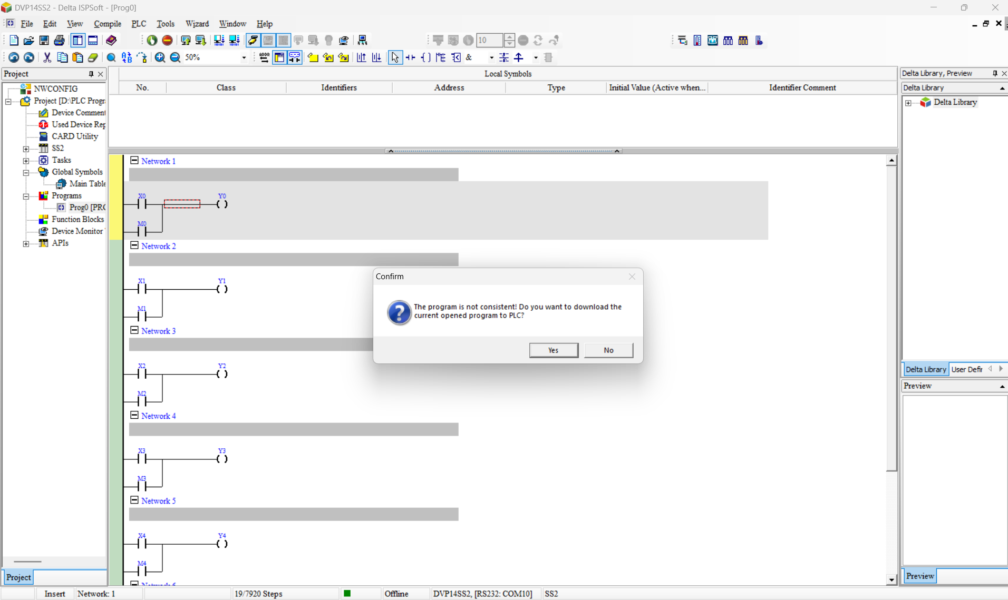
Select the option Yes

Slide 30
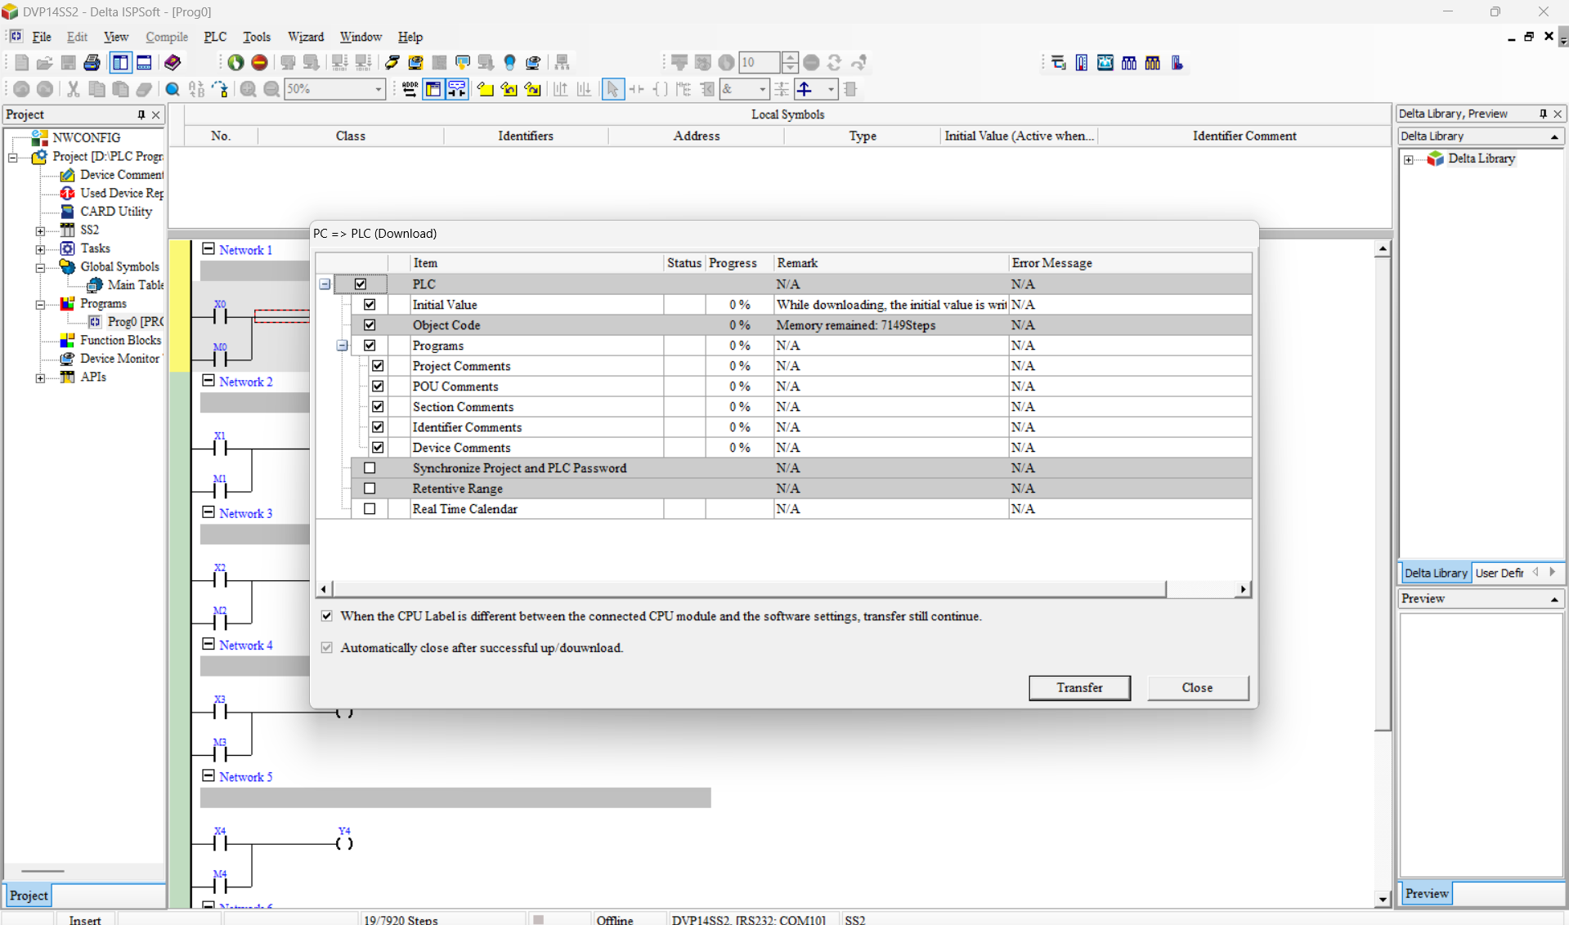
Ready for program transfer to the PLC.

Slide 31
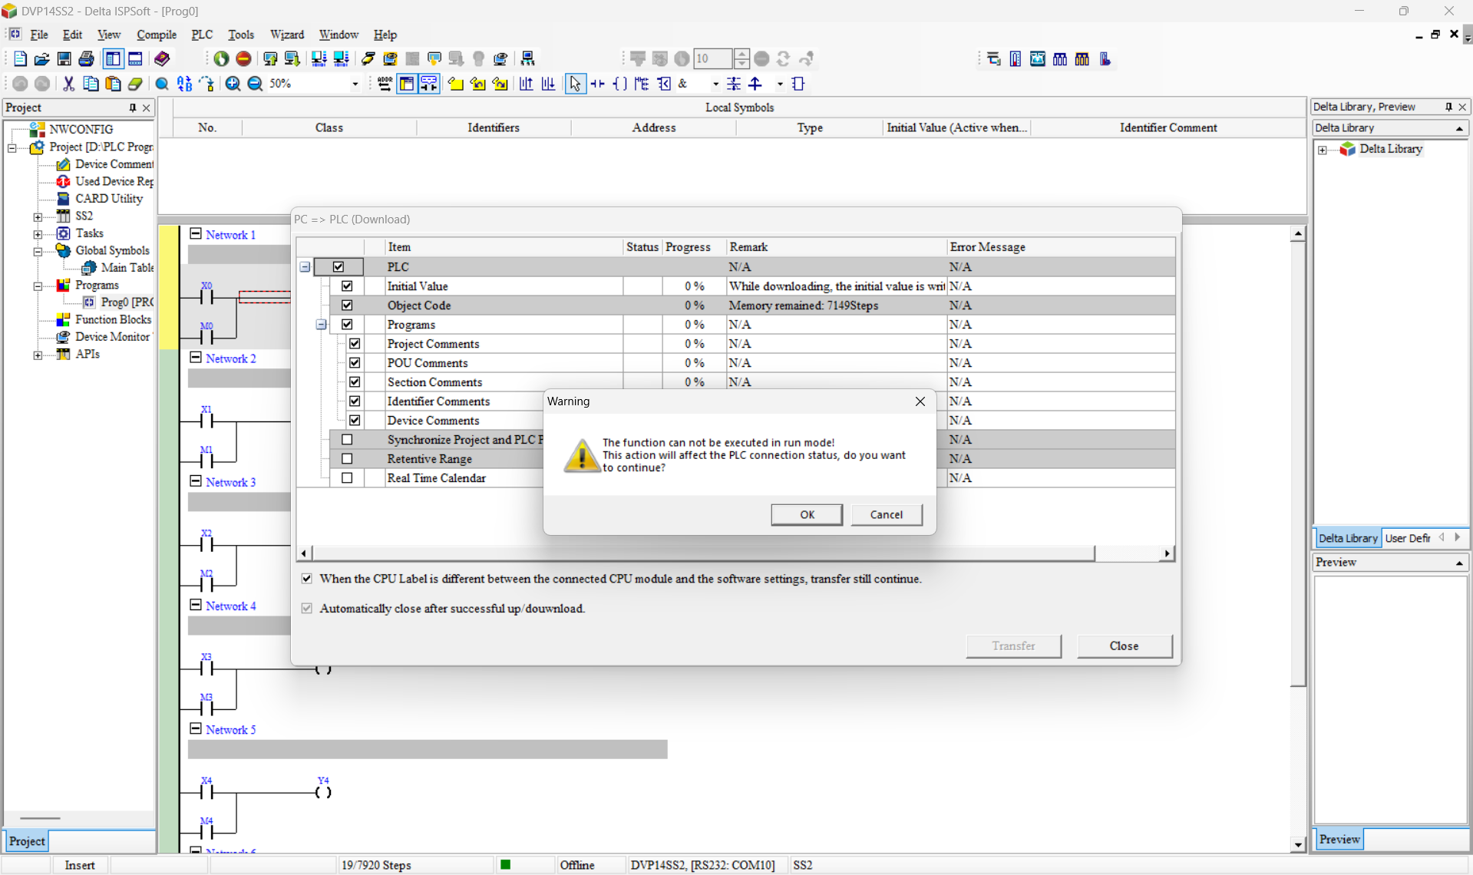
Select a Option OK

Slide 32
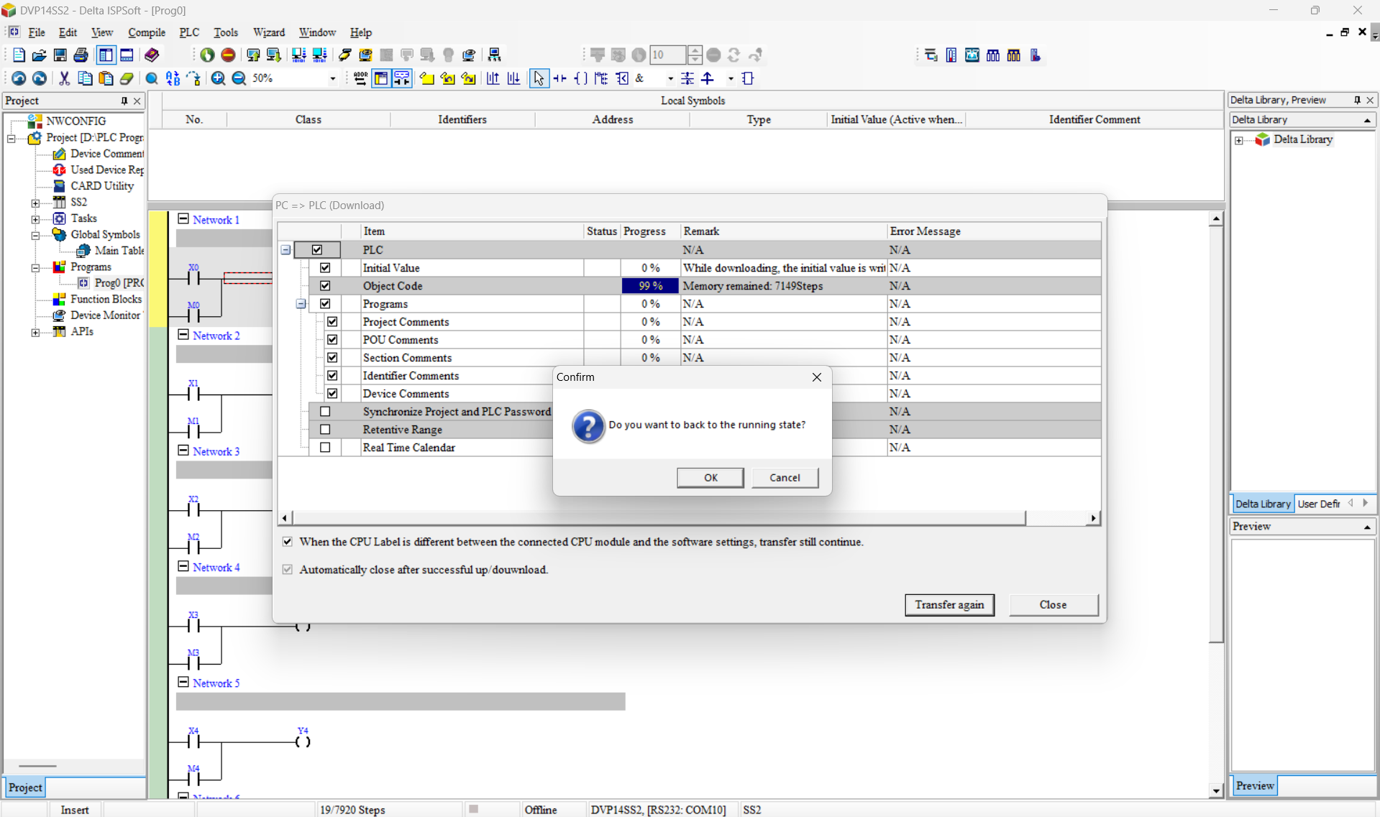
Select a option OK

Slide 33
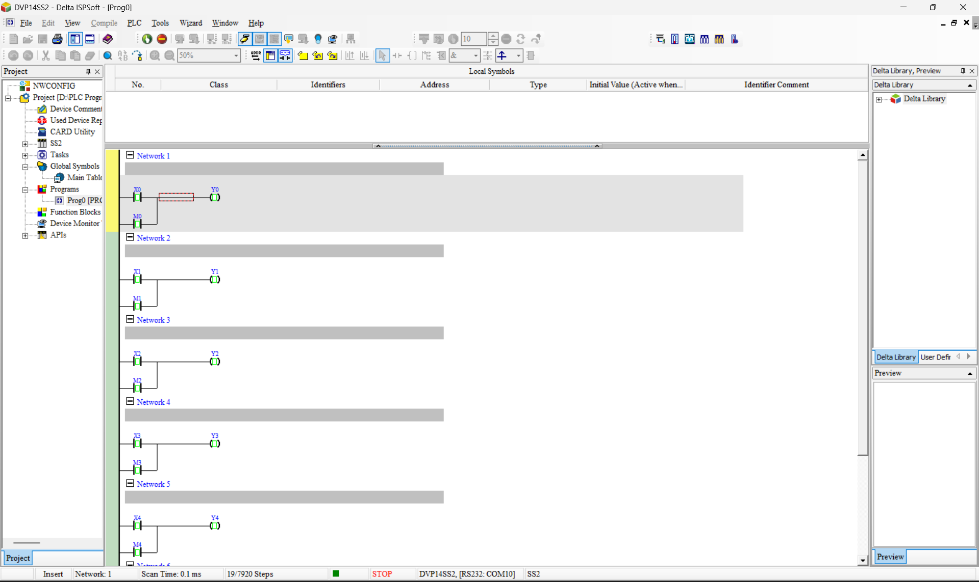
Ensure the PLC is in either STOP or RUN mode before proceeding.

Slide 34
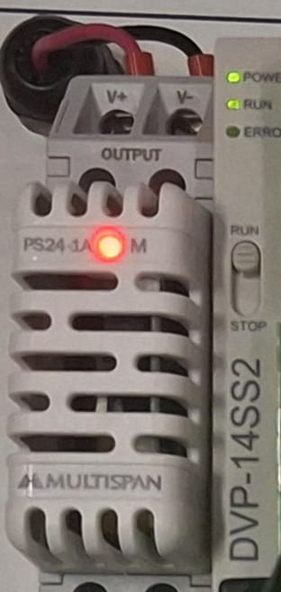
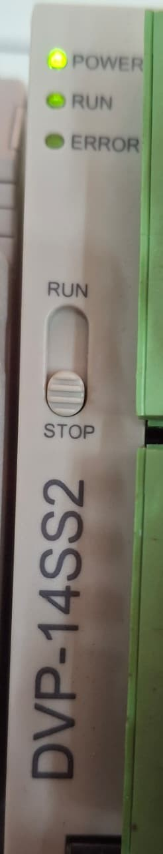

“If the system is stopped, toggle the PLC buttons in this order: RUN → STOP → RUN.

Slide 35
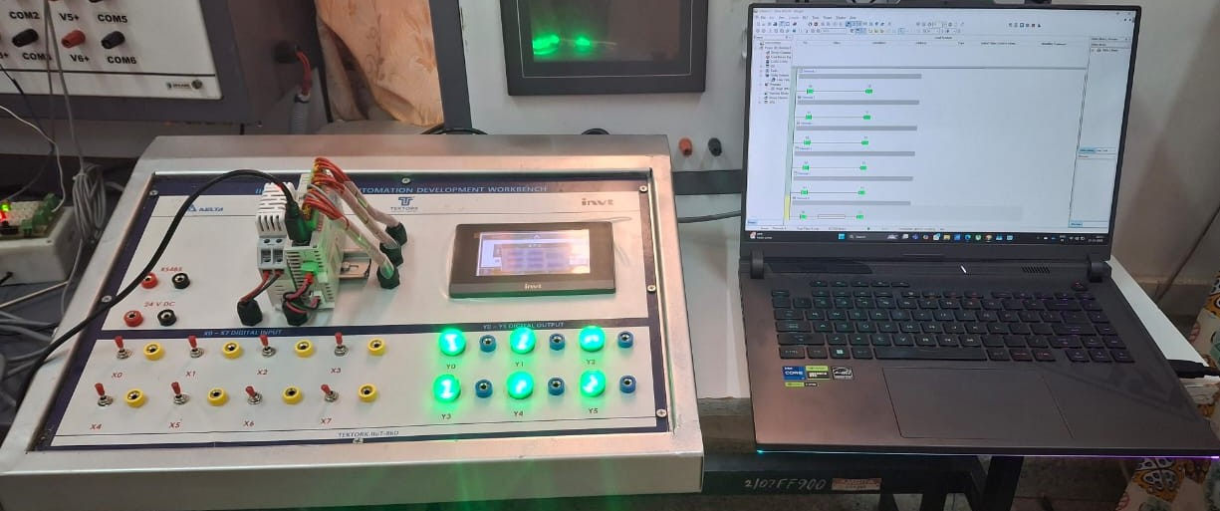
Digital Inputs and Outputs

Slide 36
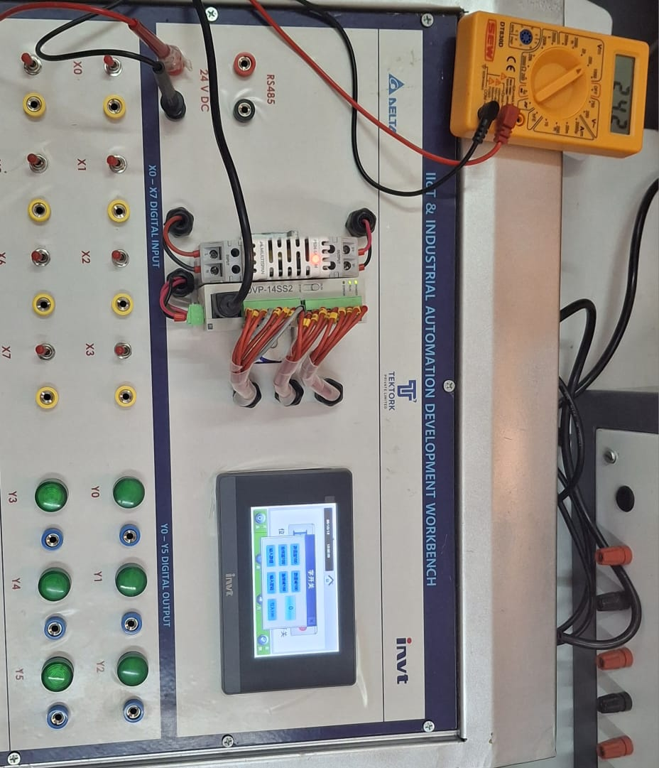
Digital Output Measurement using Multimeter

Slide 37
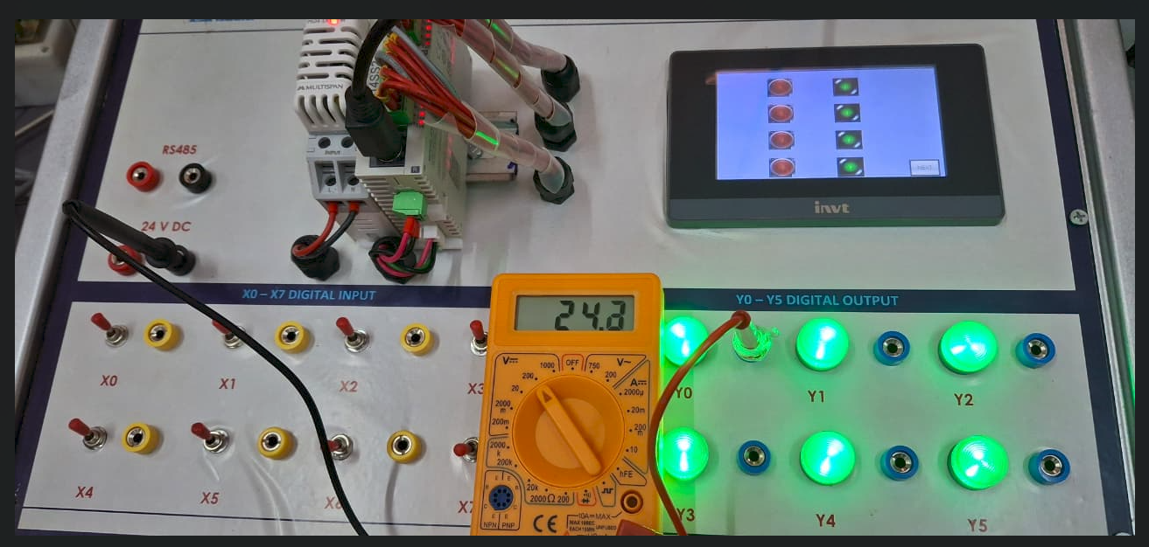
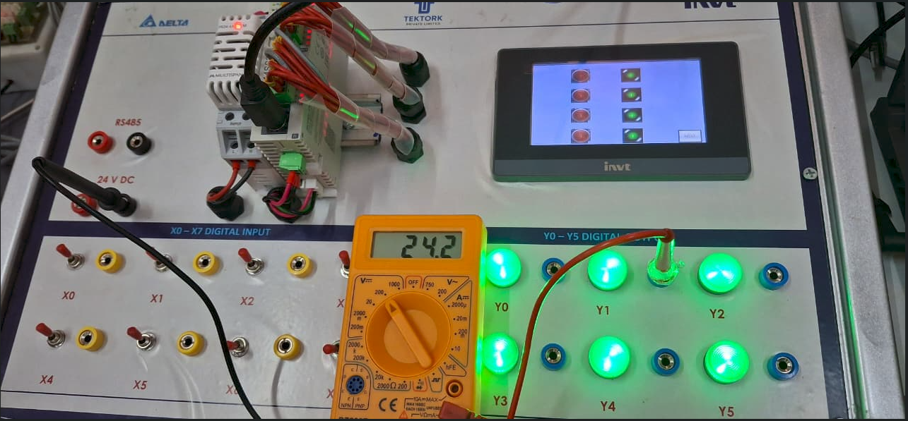
Whenever the digital input is ON and the digital output is ON, we can measure a corresponding 24 V output Respectively Input and Output

Slide 38
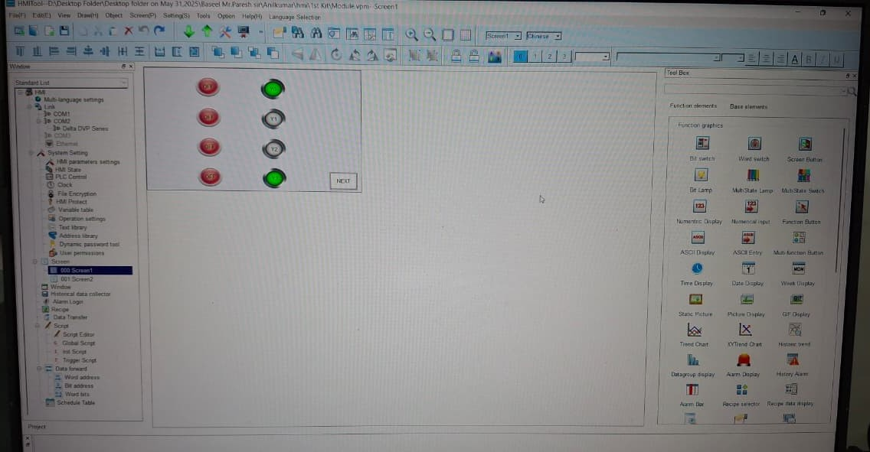
HMI TOOL for Programming

Slide 39
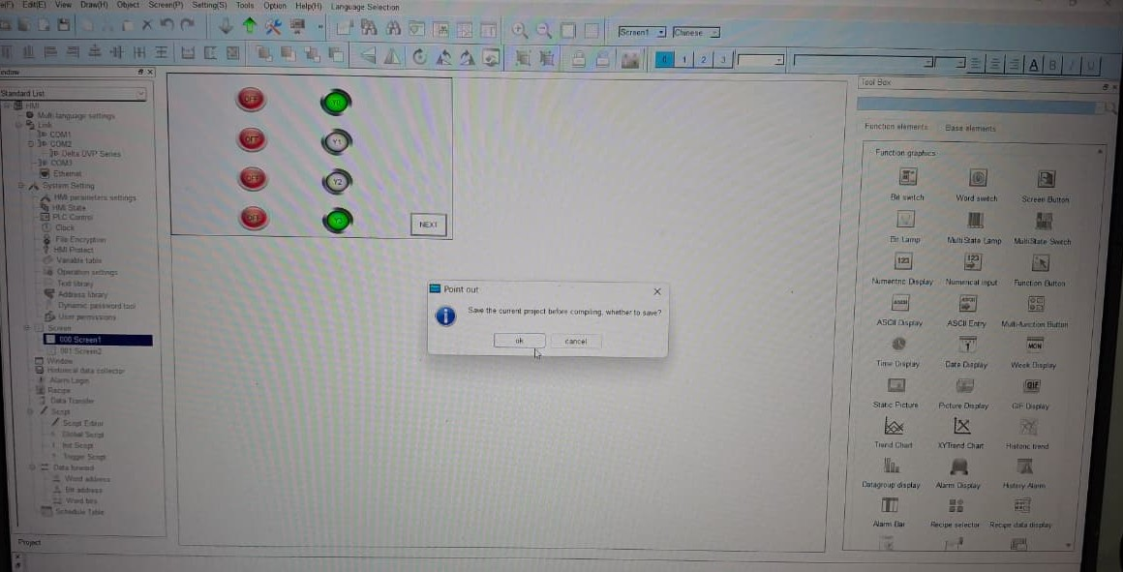
Select a Option OK

Slide 40
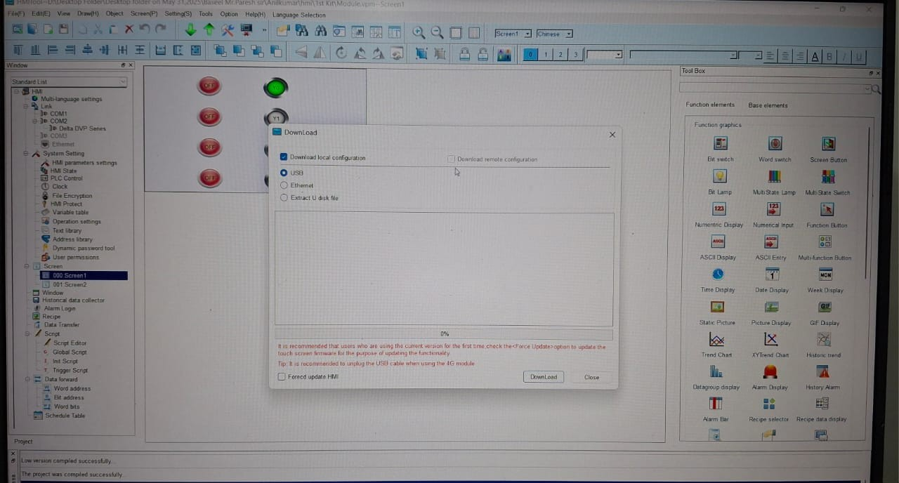
Select Option for Download

Slide 41
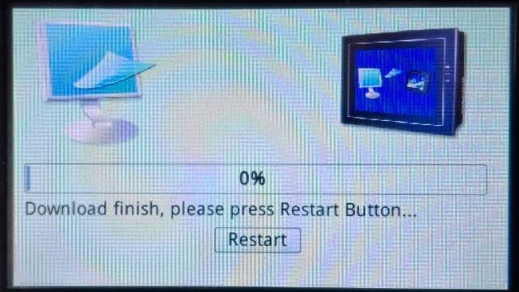
When programming the HMI screen

Slide 42
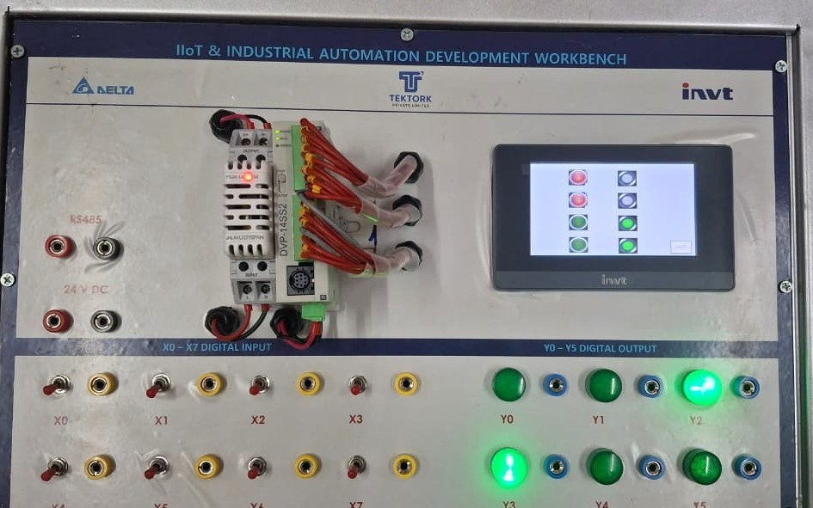
While using HMI control, the corresponding output glows.

Slide 43
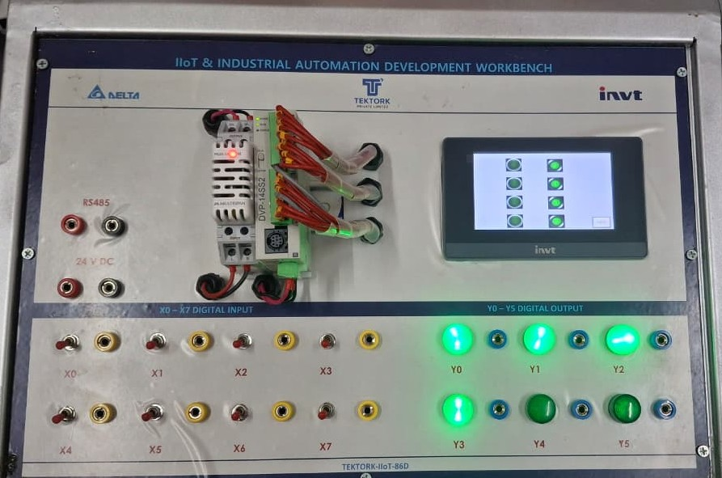
While using HMI control, the corresponding output glows.

Slide 44
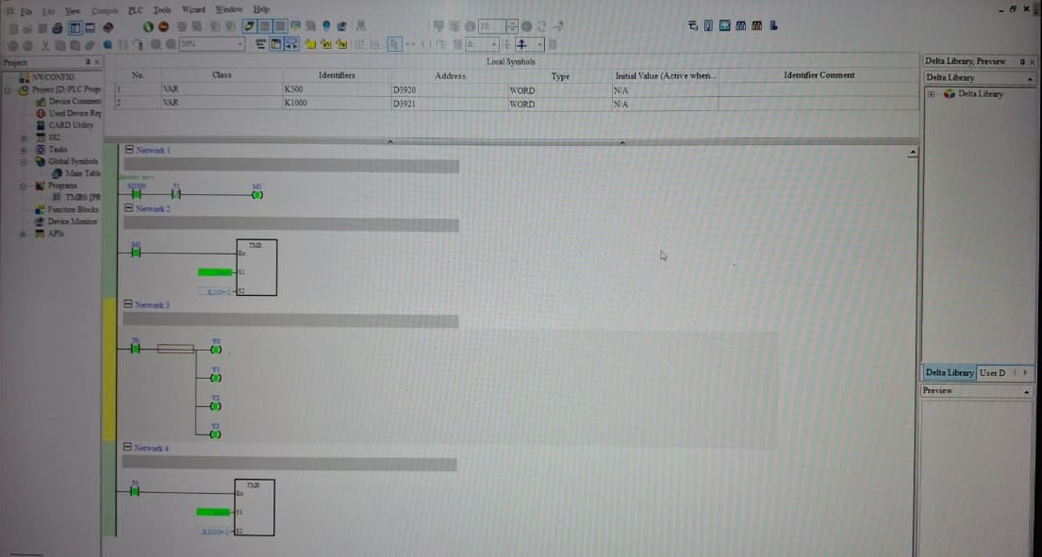
Timer Concept Execution in PLC-Based IIoT Industrial Automation Development Workbench

Slide 45
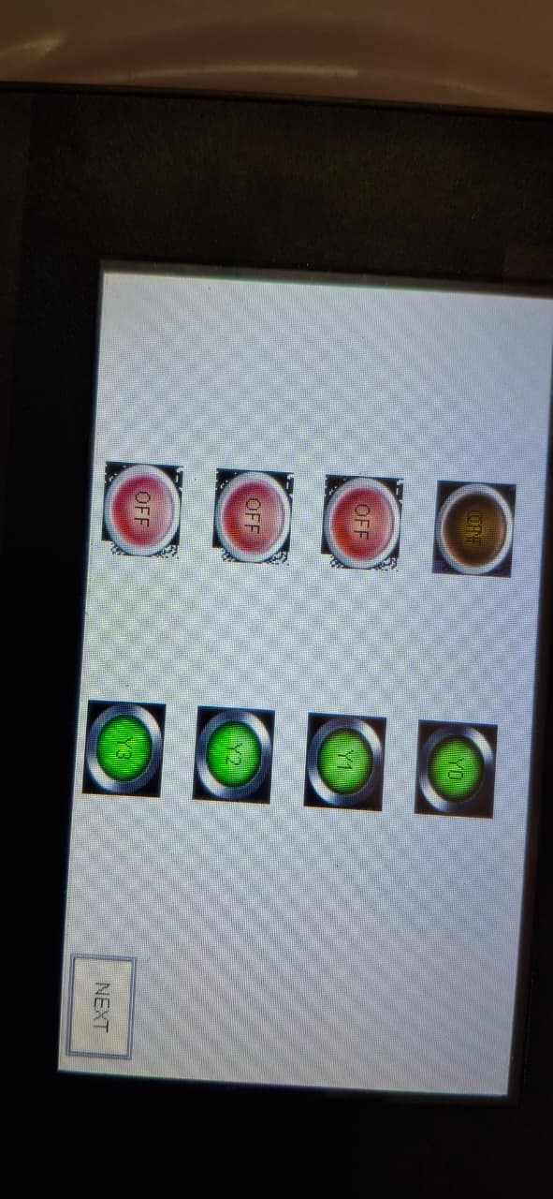
Timer Output in Human-Machine Interface Display

Slide 46
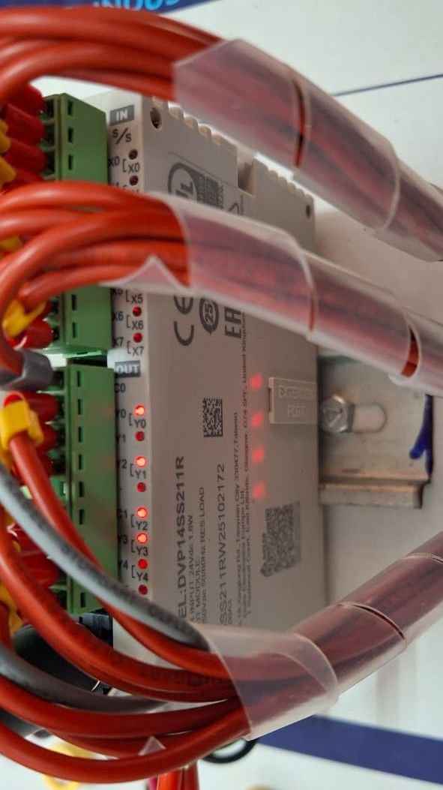
PLC output operation based on timer logic

